Slide 1


Flipkart Product Analysis
INSTITUTE OF ENGINEERING AND MANAGEMENT, KOLKATA
SALT LAKE
(School of University of Engineering and Management, Kolkata)
A Business Intelligence Dashboard Project
Powered By Power BI
_______________________________________________________________________
Presented By:
Moupiya Saha | Tanishka Saha | Sangita Das | Swastika Das | Shovon Das

Slide 2
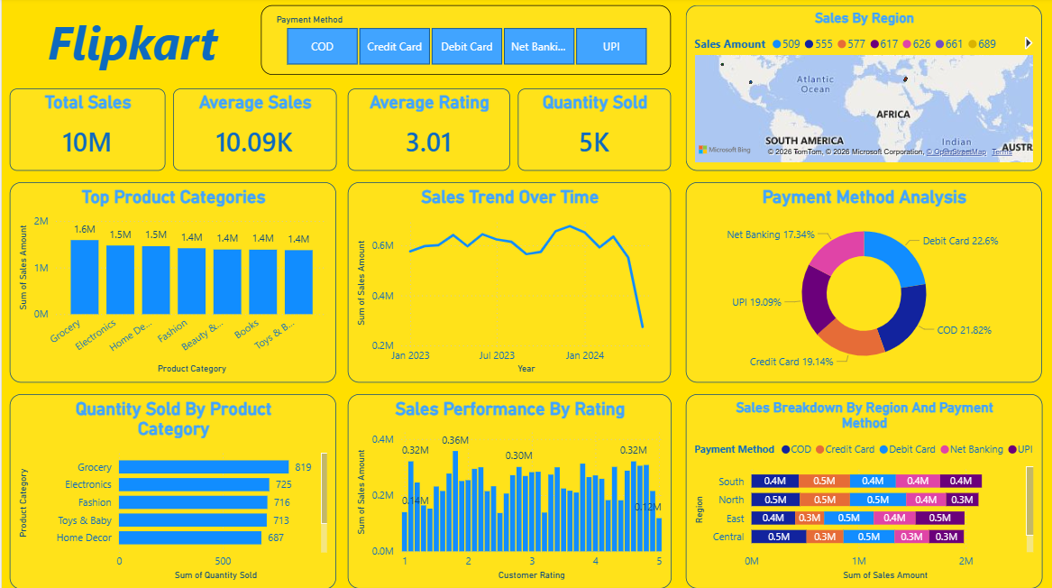
Project Overview
This project analyzes massive volumes of Flipkart Product Data using Power BI, transforming raw numbers into actionable visual intelligence.
The dashboard empowers users to understand :
Product performance across various market categories.
Historical sales trends and fluid pricing dynamics.
Customer satisfaction ratings and category-wise deep dives.
Through interactive visualizations, decisions-makers can easily identify business insights and support strategic growth initiatives.

Slide 3
Core Project Goals
Analyze & Find
Analyze extensive Flipkart product and sales datasets to pinpoint the absolute best-selling products and top-performing categories.
Compare Metrics
Compare crucial metrics including product prices, discount structures, and customer ratings to understand overarching market dynamics.
Create Dashboard
Create a highly interactive dashboard that allows business leaders to make real time, accurate, and data-driven decisions.

Slide 4
The Problem Statement
Data Overload
Large volumes of Flipkart products and sales data are incredibly difficult and time-consuming to analyze manually
Identification Challenges & Lack of Vision
Without proper visualization, recognizing seasonal sales trends, customer preferences, and top-selling categories is nearly impossible.
Time-Consuming & Inefficient Reporting
Comparing product prices, discounts and ratings takes significant time. Manual reporting is slow, error prone and entirely static.
The Solution: An interactive Power BI dashboard is required to transform this raw, disconnected data into meaningful, strategic business insights.

Slide 5
Dataset Overview & Keys
Dataset Overview
The dataset contains vital information about Flipkart products, allowing for deep categorial, operational and financial analysis.
It encompasses over 1000 real customers orders, providing a comprehensive, real-world overview of product sales behavior and consumer trends.
Dataset Keys
Primary Key : Product ID
The unique identifier across the dataset. Crucial for establishing relationships and preventing duplicate counts.
Important fields Analyzed :
Category
Brand
Price
Rating
Discount
Sales(Volume)

Slide 6
Data Modeling & Features
Data Modeling
Data cleaned & transformed using Power Query. Features optimized star schema, primary/foreign keys, and established table relationships for speed.
Data Engine
Powered by robust dataset importation, comprehensive, data transformations, and custom DAX (Data Analysis Expressions) Measures.
Visualizations
Rich UX featuring KPI Cards,
Bar Charts, Pie/Donut
Charts with dynamic slicers
and seamless
cross-filtering interactivity.

Slide 7
Proposed System Architecture
2. Cleaning
Utilize Power Query & establish Data Modeling to remove anomalies and structure.
4. Output
Deploy the final, interactive Power BI Dashboard for end-user insights.
1. Source Data
Import raw Flipkart Dataset containing orders, product details, and financials.
3. Calculations
Apply advanced DAX Measures and analytical business logic for key metrics

Slide 8
Dashboard Overview: KPI Summary
Key Performance Indicators
A high-level view of overall platform performance highlights significant revenue generation and substantial order volumes over the analyzed period.
10M
Total Sales (INR)
Average Sales Per Order
10.08K
Quantity Sold
5K Units
Average Rating
3.02/5.00
Average Discount
14.36%

Slide 9
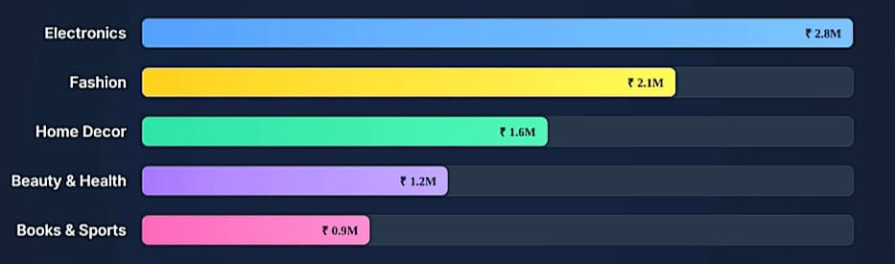
Top Product Categories
Electronics and Fashion drive the highest revenue, making up nearly 50% of the total sales volume, indicating core consumer demands on the platform.

Slide 10
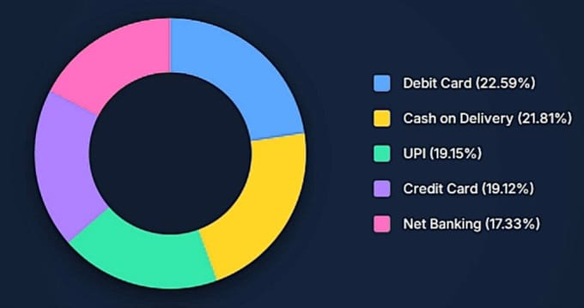
Payment Method Analysis
Customer Payment preferences are highly diversified across methods, with Debit Cards and Cash on Delivery (COD) being the most utilized.

Slide 11
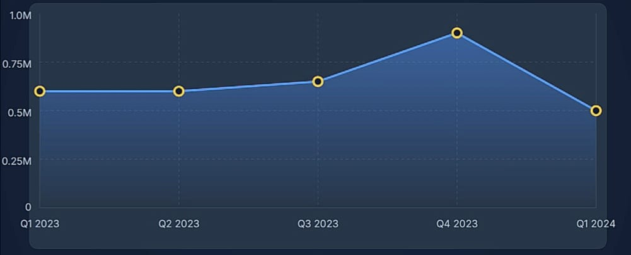
Sales Trend Over Time
Sales remained relatively stable around 0.6M (INR) throughout early 2023. We observed a significant peak in Q4 (Festive Season) before experiencing a drop entering 2024.

Slide 12
Dashboard Features
Analytical Features
Sales & Category Features
Product Performance
Price Comparison & Rating Analysis
Visual Components
Interactive Filters & KPI Cards
Dynamic Charts & Slicers
Geographic Maps for Regional Data

Slide 13
Benefits of the Project
Faster Decision-Making & Better Understanding
Real time views enable immediate strategic pivots, providing a clearer view of seasonal sales and complex customer behavior.
Interactive Reports & Easy Visualization
Translates complex, raw data into visual stories. Interactive architecture allows deep dives into specific regions, items, or timeframes.
Time-Saving Analysis & Improved Performance
Automates the previously manual, error-prone reporting process, driving strategic, high ROI actions based on solid factual data

Slide 14
Questions?
Thank you for your attention and precious time.
This project demonstrates how Power BI can transform Flipkart product data into meaningful business intelligence dashboards.
__________________________________________________
Moupiya Saha | Tanishka Saha | Sangita Das | Swastika Das | Shovon Das
Institute of Engineering and Management, Kolkata

